Slide 1
Introduction to BDD

Slide 2
“BDD is writing software that matters through continuous collaboration.”
– Dan North
“Using examples in conversation to illustrate behavior.”
– Liz Keogh
Notes:
Dan North – coined the term BDD, creator of JBehave and Rbehave
Liz Keogh – well-known blogger, and a core member of the BDD community and contributor to JBehave

Slide 3
BDD defined
In Software Engineering: Behavior-driven development is an Agile software development process that encourages collaboration among developers, QA, and non-technical or business participants in a software project
Behaviors and expected outcomes are expressed in plain text.
BDD provides a common language based on simple, structured sentences expressed in English.
In BDD, businesses, developers and testers come together to explore, discover and agree using concrete examples.
BDD is an agile way of working to help teams succeed in delivering value.
Built on the concept of Test-Driven Development (TDD).

Slide 4
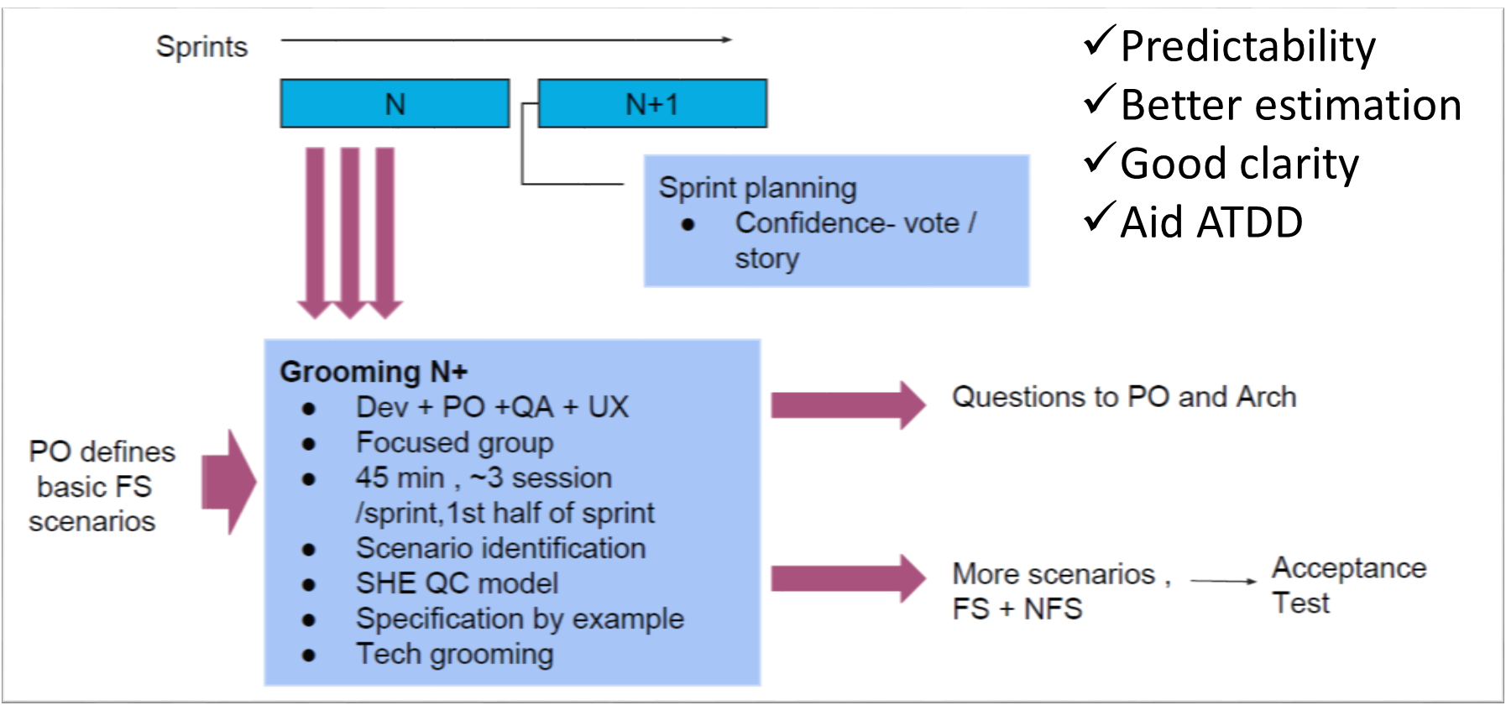
Behavior driven development , BDD
WHY
WHAT: BDD is a collaborative approach to software development that bridges the communication gap between business and IT. BDD helps teams communicate requirements with more precision, discover defects early and produce software that remains maintainable over time.
Collaboration
Predictability
Requirements Clarity
Quality
MYTH BUSTERS
BDD is not for testing
BDD doesn't require a tool
tools are for automation
Test are just an outcome
Just by Using Cucumber doesn't mean you are BDD
Its not about Given When Then
HOW
TYPICAL CHALLENGES
Misunderstanding of concept
Lack of collaboration
Using BDD frame works only for testing
HOW TO MATURE
Specification by example
ATDD
BDD

Slide 5
BDD, as a practice
BDD as a leading practice, drives quality up, waste down
A common sentence structure (Given, When, Then)
BDD enables additional forms of test-driven delivery
More connected through continuous interaction and the breaking down of siloes
Common language and collaborative conversations
Enables shift-left to identify errors earlier
Scripts are easier to maintain
Notes:
BDD as a leading practice, drives quality up, waste down, and builds a common understanding of desired outcomes that are user/customer driven
A common sentence structure (Given, When, Then) enables repeatable translation from customer use cases to test cases
BDD enables additional forms of test-driven delivery to build a healthy, highly repeatable and economical feedback system for developers, product owners and stakeholders
Business and technology become more connected through continuous interaction and the breaking down of siloes
Common language and collaborative conversations reduce bad assumptions and miscommunication lowering rework and churn
Enables shift-left to identify errors earlier when they are less expensive to fix
Lends itself to more modular, parameterized, variable driven tests that are easier to maintain

Slide 6
How you collaborate ?

Slide 7
Challenges in Collaboration

Slide 8
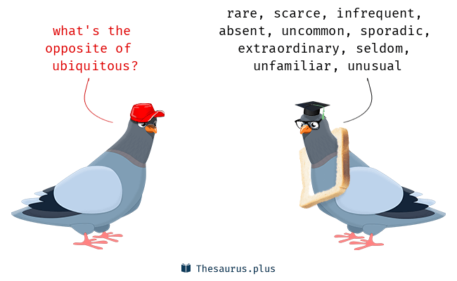
What if we talk Ubiquitous language

Slide 9
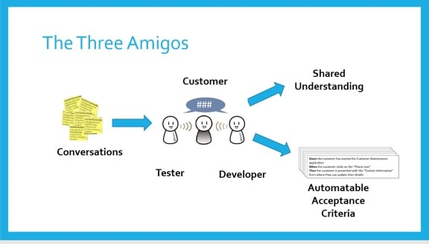
Notes:
“The Three Amigos” refers to a meeting of the minds of the three primary roles involved in producing software:
Business – Often named the “business analyst” (BA) or “product owner” (PO), the business role provides what problem must be solved. They provide requirements for the solution. Typically, the business role is non-technical.
Development – The developer role provides how the solution to the problem will be implemented. They build the software and must be very technical.
Testing – The testing role, sometimes named “quality assurance” (QA), verifies that the delivered software product works correctly. They also try to find defects. The tester role must be somewhat technical.
Ideally, when The Three Amigos meet during grooming and planning, they would formalize acceptance criteria as Gherkin features. Those feature files are then used directly by the developer for direction and the tester for automation. They act like a receipt of purchase for the business role – the feature file says, “This is what you ordered.”
Remember, the ultimate purpose for The Three Amigos is higher quality in both the product and the process. Nobody wants more meetings on their calendar, but everyone can agree that quality is necessary.

Slide 10
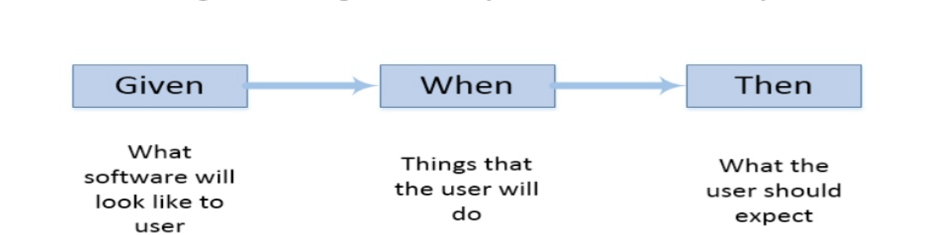
BDD, Gherkin Plain language syntax
Gherkin is a simple syntax that allows teams to write business readable, executable specifications
Gherkin effectively turns the specification into automated tests
Gherkin helps to express behavior of the System
Gherkin provides a common set of keywords to document features in both English and native languages within a feature file
“Given [initial context], when [event occurs], then [ensure some outcomes]”
“Given” is the context for the scenario. It sets system into initial stage before executing scenario.
“When” is an action/event, it’s an event in the system that will cause an action or an outcome.
“Then” is the outcome, It’s the behavior of the system based on action that happens in given context.

Slide 11
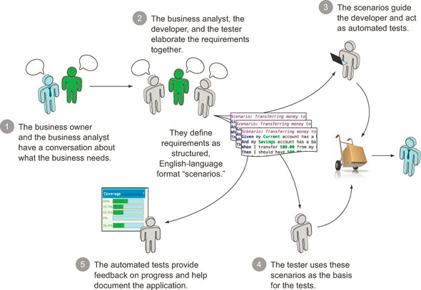
The BDD school of thought ,Outside in
Code
Test
Spec
Outside in

Slide 12
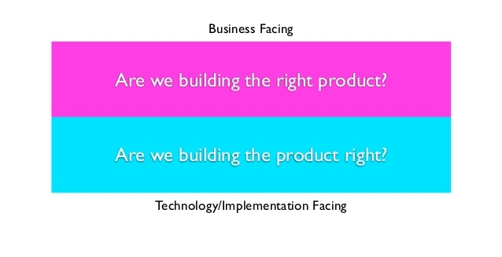
TDD Vs BDD
BDD
TDD

Slide 13
Let’s write Gherkin

Slide 14
Story Example
As a premium customer, I expect roaming to be automatically enabled and disabled based on time and call signals, so that I do not get overcharged.
As a premium customer, I expect the service provider to provide a complimentary service for a short time with an option to upgrade at an additional cost so that I do not choose other service providers.
As a premium customer, I expect the service provider to be transparent in their pricing and do not have hidden clauses that can possibly overcharge me.

Slide 15
Demo

Slide 16
Test First
specification by example
Specification by example (SBE) is a collaborative approach to defining requirements and business-oriented functional tests for software products based on capturing and illustrating requirements using realistic examples instead of abstract statements.
The given part describes the state of the world before you begin the behavior you're specifying in this scenario. You can think of it as the pre-conditions to the test.
The when section is that behavior that you're specifying.
Finally the then section describes the changes you expect due to the specified behavior

Slide 17
Scenario 2: Account has insufficient funds
Given the account balance is \$10
And the card is valid
And the machine contains enough money
When the Account Holder requests \$20
Then the ATM should not dispense any money
And the ATM should say there are insufficient funds
And the account balance should be \$10
And the card should be returned
As an Account Holder
I want to withdraw cash from an ATM
So that I can get money when the bank is closed
Scenario 1: Account has sufficient funds
Given the account balance is \$100
And the card is valid
And the machine contains enough money
When the Account Holder requests \$20
Then the ATM should dispense \$20
And the account balance should be \$80
And the card should be returned

Slide 18
Gherkin Keywords
Feature
Rule (as of Gherkin 6)
Example (or Scenario)
Given, When, Then, And, But for steps (or *)
Background
Scenario Outline (or Scenario Template)
Examples (or Scenarios)
There are a few secondary keywords as well:
""" (Doc Strings)
| (Data Tables)
@ (Tags)
# (Comments)

Slide 19
Feature file Basic structure of a feature file
Feature: ATM Withdrawl Scenario 1: Account has sufficient funds
Given the account balance is \$100
And the card is valid
And the machine contains enough money
When the Account Holder requests \$20
Then the ATM should dispense \$20
And the account balance should be \$80
And the card should be returned
Scenario 2: Account has insufficient funds
Given the account balance is \$10
And the card is valid
And the machine contains enough money
When the Account Holder requests \$20
Then the ATM should not dispense any money
And the ATM should say there are insufficient funds
And the account balance should be \$20
And the card should be returned
The format of a basic feature file will look very similar to the right
You can add any number of scenarios within a feature file
19

Slide 20
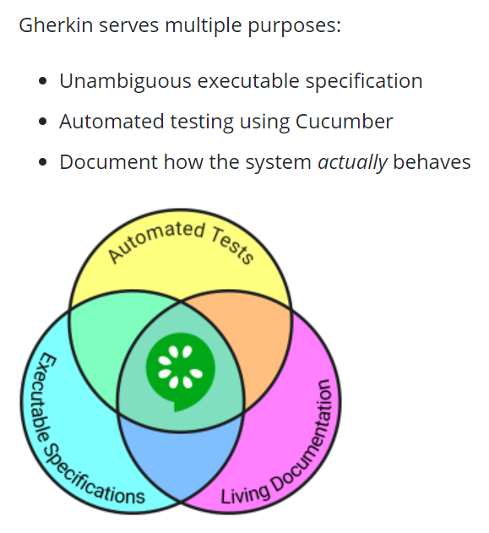

Slide 21

What is Cucumber ?
Cucumber is a software tool that supports behavior-driven development (BDD).^{[7][8][9][10]} Central to the Cucumber BDD approach is its ordinary language parser called Gherkin. It allows expected software behaviors to be specified in a logical language that customers can understand. As such, Cucumber allows the execution of feature documentation written in business-facing text.^{[11][7][8]} It is often used for testing other software.^{[12]} It runs automated acceptance tests written in a behavior-driven development (BDD) style.^{[13]}

Slide 22

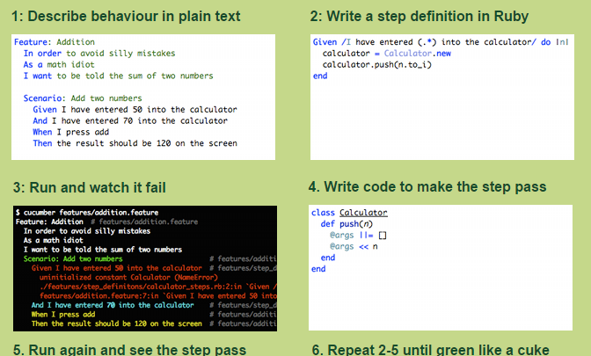
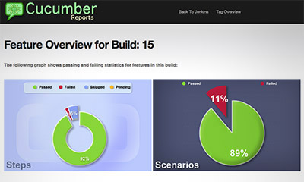
Cucumber – a BDD tool “Until your code is green like a cuke”
22

Slide 23
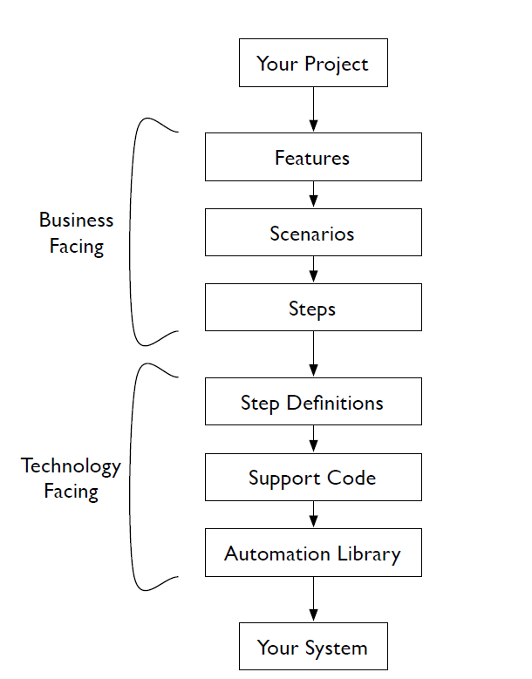

Slide 24
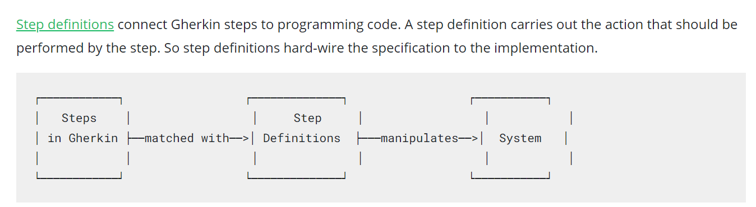
What is Step Definition File ?

Slide 25
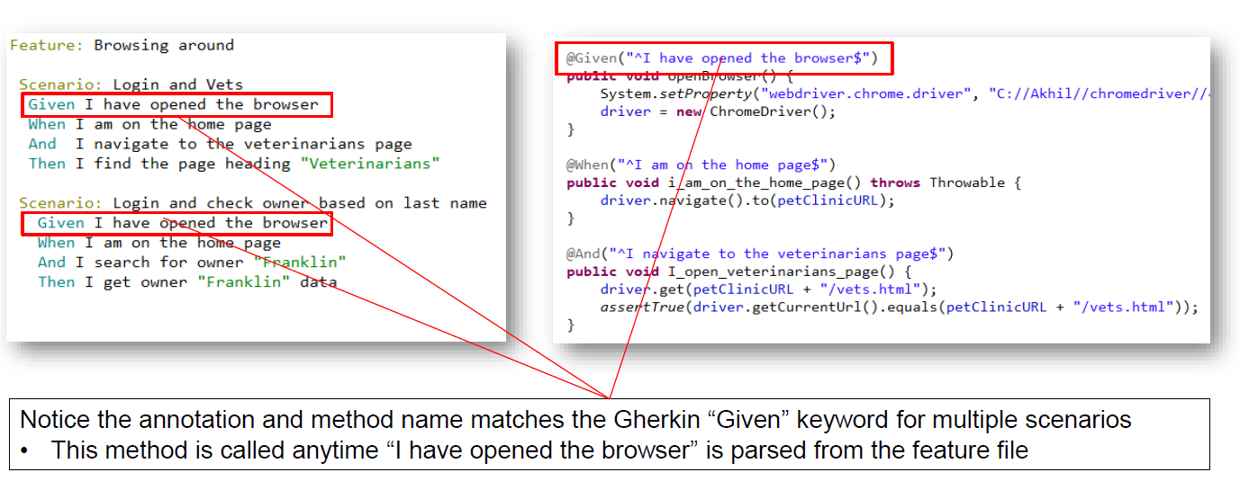

Slide 26
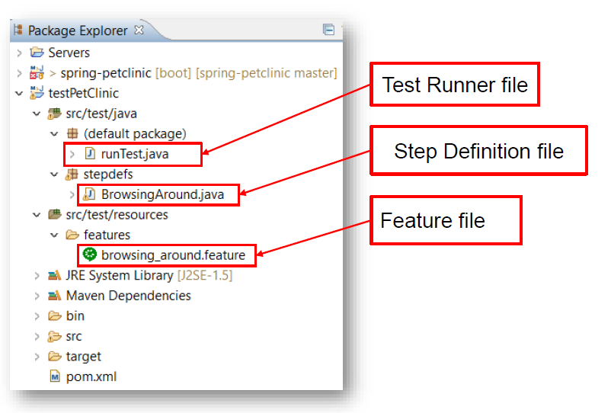

Slide 27
BDD in action
… collaboratively to discover the scope of the behavior.
Start
Once behavior is agreed upon, formulate the specification in business-readable language.
Finally, automate the formulated specification to verify that the system behaves as expected.
27

Slide 28
Steps of BDD Step 1: Discover the scope of the behavior – three amigos
Work with businesses to discuss a desired functionality/idea or feature.
During three amigos, the team uses concrete examples to ensure that they have a shared understanding of the functionality they're about to develop.
Example:
Business owner of a new bank wants customer to withdraw specific amount from a saving account
Developer’s perspective : remainingBalance = currentBalance – withdrawalAmount;
Tester’s perspective: What if currentBalance is zero OR account holder enters negative withdrawal amount OR accountNumber is wrong.

Slide 29
Steps of BDD Step 2: Define behavior in feature file using Gherkin format
Concrete examples discussed during meetings are formulated into Gherkin scenarios.
Each scenario is an example.
While writing the scenario, focus on the observable, testable behavior of the system.
Each line in a scenario that begins with one of the Given / When / Then keywords is called a step.
Example:
Feature: Withdraw money
Scenario: Enough balance in account
Given there is enough money in customer account
When customer makes withdrawal
Then customer gets expected amount
And balance is updated in account

Slide 30
Steps of BDD Step 3: Run feature and see if it fails
When we run feature in step 2, we get alerted by the compiler to write a step definition.
If feature runs without any errors, that means it is already implemented and no further work is needed. This step catches duplicate code.
Following snippet will be displayed:
You can implement missing steps with the snippets below:
@Given("^there is enough money in customer account$")
public void there_is_enough_money_in_customer_account() {
// Express the Regexp above with the code you wish you had
throw new PendingException();
}
The PendingException is a special type of exception provided by Cucumber to allow the development team to signal that automation for a step is a work in progress. It differentiates between steps that aren't finished yet and steps that are failing due to a defect in the system.

Slide 31
Steps of BDD Step 4: Create matching step definitions and make it run
We add code for new steps in step definition file.
Step definition should call the application to do whatever the Gherkin step describes.
Run the test and update the code if it fails. Make it pass.
Here we have an opportunity to do some software design. We can decide how to interact with application/system.
We can interact with system through the User Interface or by making a call to the programmer API directly.
We can do all of this without writing any implementation yet. We can mock/stub our responses.
This is known as "outside-in" development: it helps us to implement solution based on real needs.
This step is a programming language dependent step.

Slide 32
Steps of BDD Step 5: Repeat
Repeat steps 2 to 4 for all scenarios of the feature.
This is the decision step.
Business analyst/PO/testers can provide more insights with more examples.
Consider all positive and error scenario and keep repeating until feature is implemented correctly.
Example:
Scenario: Low balance in account
Given there is less money in customer account
When customer make withdrawal
Then customer gets an error
And customer is informed about low balance

Slide 33
Adding background
Background is a set of steps that run before each of the scenarios you define
It should be used when you have the same initial Gherkin statements used for each scenario within a feature
You can now combine consistently reused initial steps into one place instead of copying and pasting them in each scenario.
For each scenario, the background sets up “Greg”, the two blogs, and “Dr. Bill”, which can then be referenced within any scenario
Feature: Multiple site support Background: - Given a global administrator named "Greg" - And a blog named "Greg's anti-tax rants" - And a customer named "Dr. Bill" - And a blog named "Expensive Therapy" owned by "Dr. Bill" Scenario: Dr. Bill posts to his own blog - Given I am logged in as Dr. Bill - When I try to post to "Expensive Therapy" - Then I should see "Your article was published." Scenario: Dr. Bill tries to post to somebody else's blog, and fails - Given I am logged in as Dr. Bill - When I try to post to "Greg's anti-tax rants" - Then I should see "Hey! That's not your blog!" Scenario: Greg posts to a client's blog - Given I am logged in as Greg - When I try to post to "Expensive Therapy" - Then I should see "Your article was published."
Page 33
Source: https://github.com/cucumber/cucumber/wiki/Background
33

Slide 34
Scenario Outlines
Sometimes tests involve the exact same scenario but with different values
This can lead to a lot of copy and pasting and lengthy feature files
Solution? Scenario Outline or Scenario Template
Scenario Outline/Template transforms multiple scenarios like the one below into just one scenario
The outline is run once every row within the Examples section
The step definition file (discussed later) will need to match the values in the Examples section
Scenario: eat 5 out of 12 - Given there are 12 cucumbers - When I eat 5 cucumbers - Then I should have 7 cucumbers Scenario: eat 5 out of 20 - Given there are 20 cucumbers - When I eat 5 cucumbers - Then I should have 15 cucumbers
Scenario Outline: eating - Given there are <start> cucumbers - When I eat <eat> cucumbers - Then I should have <left> cucumbers Examples: | start | eat | left | | 12 | 5 | 7 | | 20 | 5 | 15 |
Page 34
Page 34
Page 34
34

Slide 35
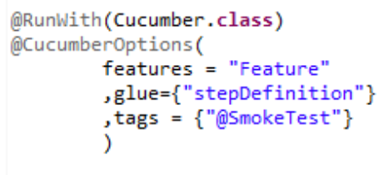
Tags
Feature: Browsing around
@RegressionTest @SmokeTest
Scenario: Login and land on home page
- Given I login to "PetClinic" application
- And I land on the "PetClinic" home page
@RegressionTest
Scenario: Login and Vets
- Given I login to "PetClinic" application
- Then I search for "Veterinarian"
- And I get a list of "Veterinarian"
@RegressionTest
Scenario: Login and check owner based on last name
- Given I login to "PetClinic" application
- And I search owner "Franklin"
- And I get owner "Franklin" Informations
Cucumber by default runs all scenarios in all the feature files. What if we want to run specific features?
To run specific features at specific time, we use tags.
For example: we can run subset of regression suite to run smoke test.
Cucumber will run only those features specific to given tags.
We can specify multiple tags in one feature file.
Page 35
Runner Class looks like this
35

Slide 36
Hooks
Cucumber hook allows us to better manage the code workflow and helps us to reduce the code redundancy.
Hooks are blocks of code that run before or after each scenario. We can define them anywhere in step definition layers, using the methods @Before and @After.
The after hook will execute for sure even if test fails
Example:
@Before public void setUp(){
driver= new ChromeDriver();
}
@After public void cleanUp(){
driver.close();
}
Page 36
Tagged Hooks
We can also tag if we want before and after hooks to be executed with a specific tag only.
Example:
@Before(@smoketest)
@Before(@dev,@wip)
36

Slide 37
Best practices
Scenarios
Given-When-Then should be in sequence.
Each scenario should ideally have only one 'When' clause that clearly points to the purpose of the test.
Use past tense for 'Given' clauses, present tense for 'When' and future tense for 'Then'.
Use 'And' clause to add multiple Given and Then steps.
Put scenarios prerequisite steps in 'Background'. Note: if the prerequisite steps are more technical, then use Before hook.
Scenarios should be more functionality oriented rather than UI/UX actions.
Write scenarios after talking to business owners.
Step Definitions
Don't call a step definition method from another method.
Never hard code any test data in step definition.

